Slide 1
Cricket Wales Survey 2020
North Wales Cricket League

Slide 2
Detail of the responders of the survey
190 responses who affiliate themselves to North Wales Cricket league
169 of the responses were from players
16 represent U18 players
6 represent volunteers form within the club
26 % said they played about the same
62 % played less than 2019 season
12 % Played more than last year

Slide 3
Standard of players played the majority of cricket in 2020 season.

Slide 4
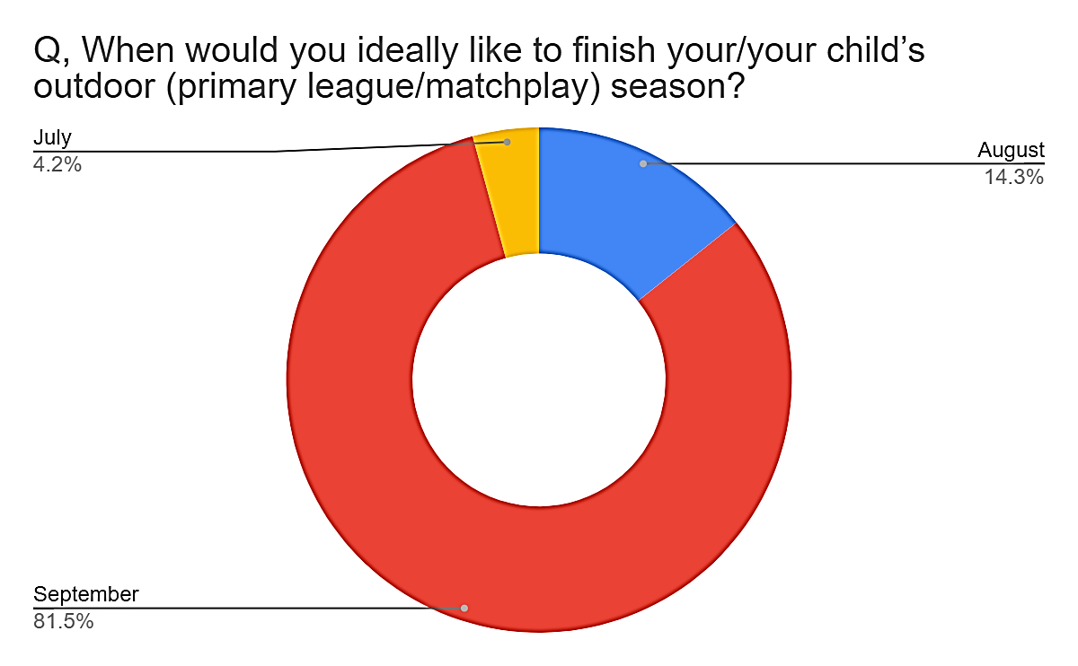
Preferred start & Finish times of the Season

Slide 5
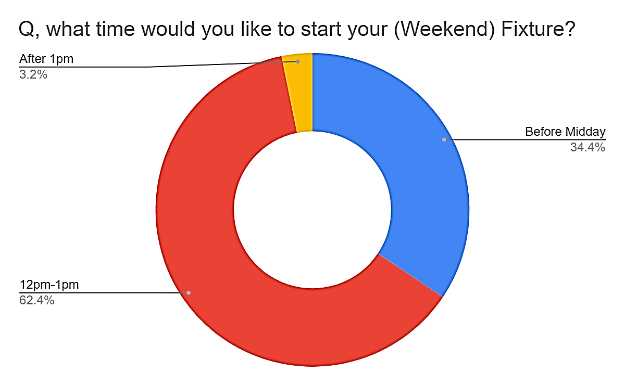
Format/duration & match start times

Slide 6
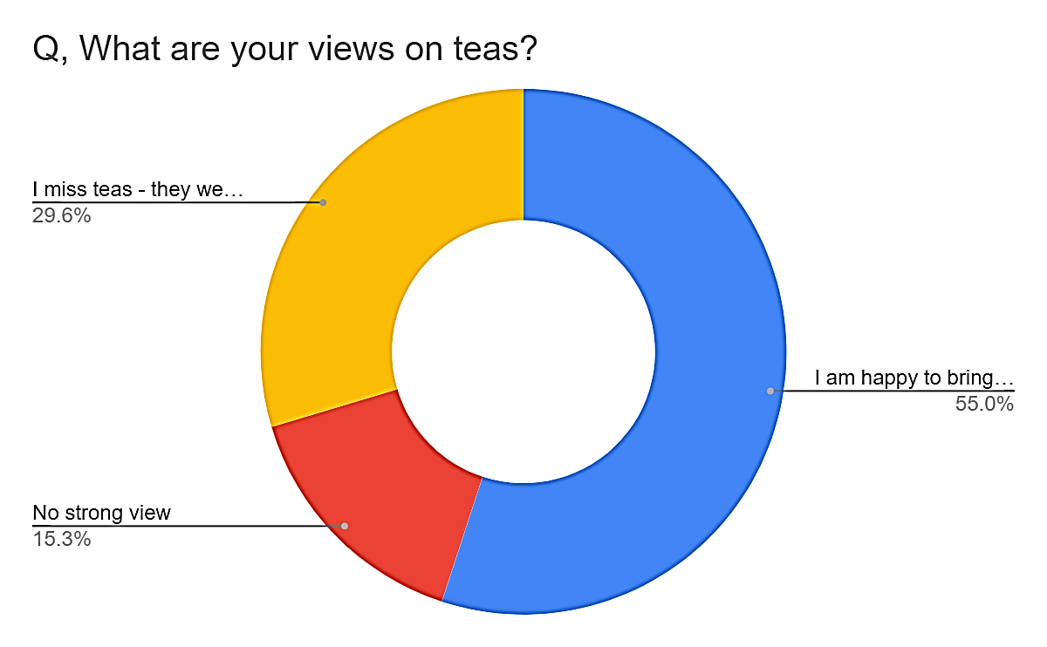
Views on cricket clothing & teas

